Slide 1
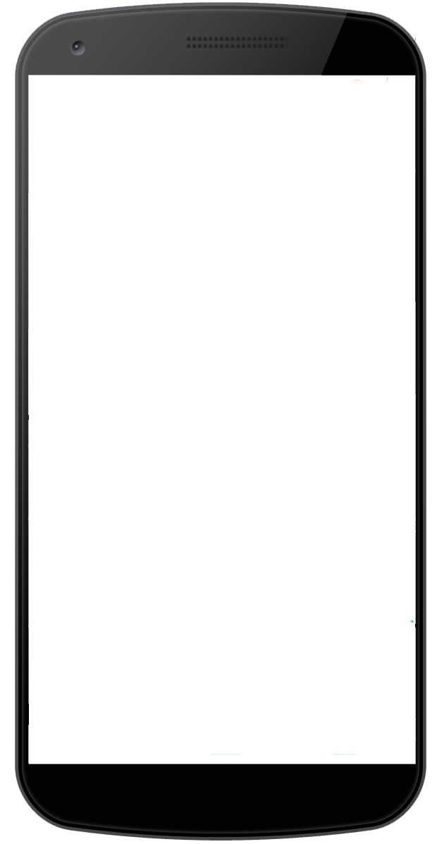
1. Login
> insert :username
> insert :password
> hit enter or Login
:username
:password
Login
Create

Slide 2

2.
Character
Battle
Shop
Stats
Gear
Skills
Rank

Slide 3
Attribute points: 0
Character
Battle
Shop
10
0
0
Magicka 2000
Health 450
Stamina 1300
Spell DMG 1108
Spell Crit 14%
Spell Res 12891
Attack Power 1108
Focus Rating 100
Armor penetration 7781
Spell Resistance 51
Healing taken 0
Cold Resistance
Flame Resistance
Lightning Resistance
Physical Resistance
Stats
Gear
Skills
Rank

Slide 4
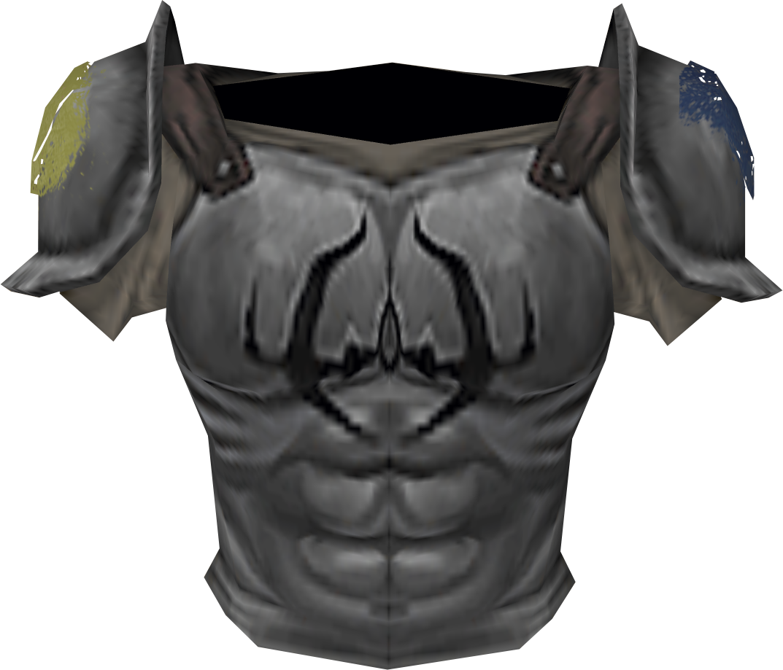
Character
Battle
Shop
Stats
Gear
Skills
Rank

Slide 5
Character
Battle
Shop
Class
Weapon
Armor
World
Guild
Racial
Guild
Stats
Gear
Skills
Rank

